Slide 1
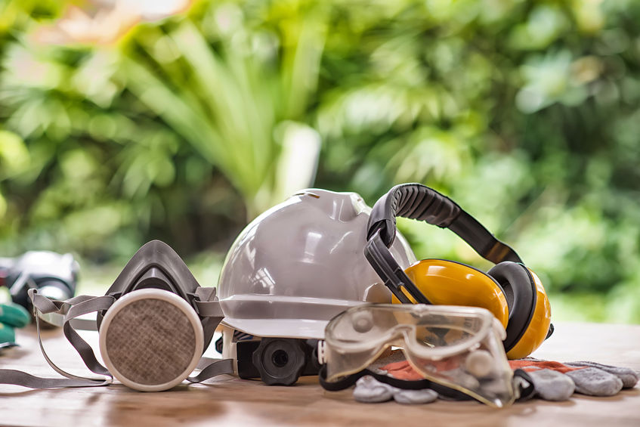
Personal Protective Equipment

Slide 2
Engage Us Safety Goal & Responsibilities
Here at Engage our goal is Zero Harm to employees
We promote safety on-site, in-office and over all through:
Site Safety Assessments prior to employee placements
Risk Assessment & Potential Hazard Identification on work tasks
Working with clients to increase safety awareness and reduce incidence of injury or harm on site
Regular contact with clients and employees on-site to address concerns
Provide PPE and site specific details to candidates
Integrated employee focused return to work & rehabilitation
We Promote Safety with our Clients & Candidates
Ensure clients promote best practice Occupational Health & Safety systems
Ensure candidates are ‘work-aware’ and can commit to the Engage Safety System expectation

Slide 3
What Are Your Obligations?
Engage Employees – It is your responsibility to:
Follow health and safety instructions provided by the employer & host client
Correctly use personal protective equipment and clothing as directed
Maintain the personal protective equipment in good working condition
Immediately report work related injuries, incidents & near misses to host client & employer
Report hazards & risks to host client & employer
Cooperate with employer & host client on Work Health & Safety Matters including:
Inductions
Site Specific Instructions
Pre-Employment Checks and Requirements

Slide 4
Personal Protective Equipment (PPE)
PPE is any physical material, barrier, clothing or apparatus worn or utilized by worker in the course of their duties to keep them healthy and safe.
Typically, PPE will include items such as:
Safety Boots Eye Protection Hard Hats High Visibility Clothing Coveralls | Hearing Protection Respiratory Protection Gloves Safety Harness Durable Clothing

Slide 5
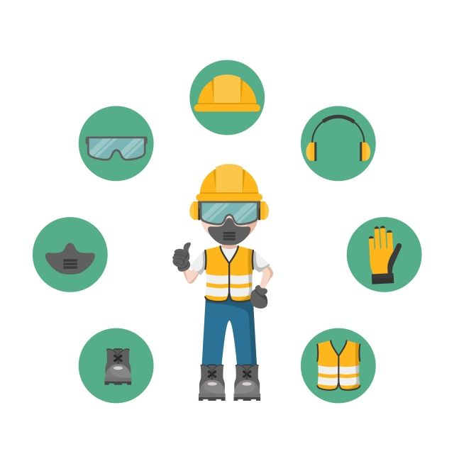
Hard Hat
Eye Protection
Hearing Protection
Respiratory Protection
Safety
Gloves
Safety Footwear
High Visibility Clothing

Slide 6
Hard Hats / Safety Helmets
Safety helmets or Hard Hats have an effective working life from the date of issue. Some safety helmets have a date of manufacture embossed on the underside of the brim.
All compliant safety helmets have a label on the inside of the shell with important manufacturer warning advice and a label with space to record the date of issue.
Hard Hats should be worn with the brim facing forward and adjust the suspension system to fit snugly on your head. It is recommended that you do not wear other head gear, such as a baseball style caps, underneath a hard hat. Caps and other head gear may prevent the hard hat from sitting on the head correctly. Metal studs and buttons, often found on caps, may cause additional injury if the hard hat is struck by a falling object.
You should inspect all aspects of the helmet at least weekly. Look out for signs of:
Dents Impact damage Discolouration | Cracks Penetration Rough Treatment

Slide 7
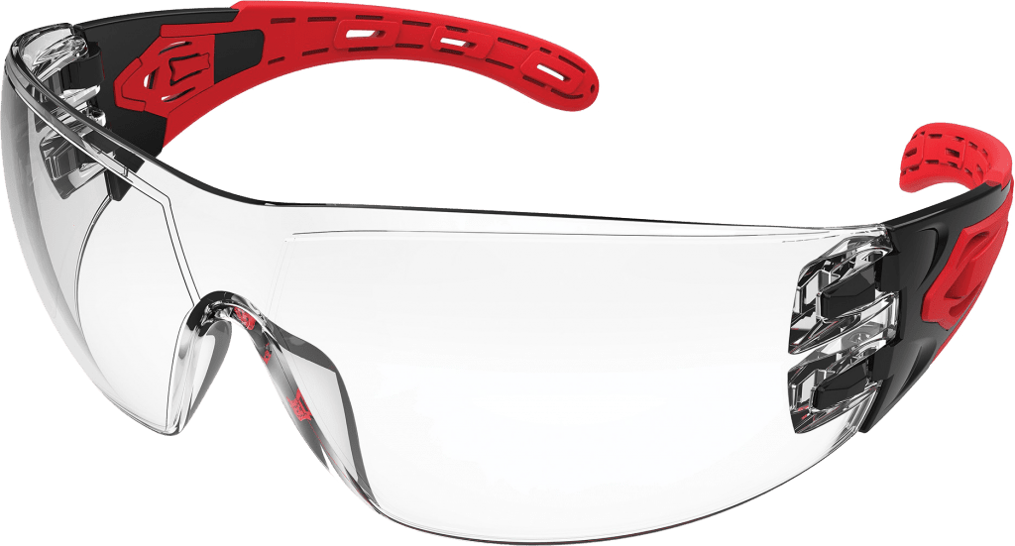
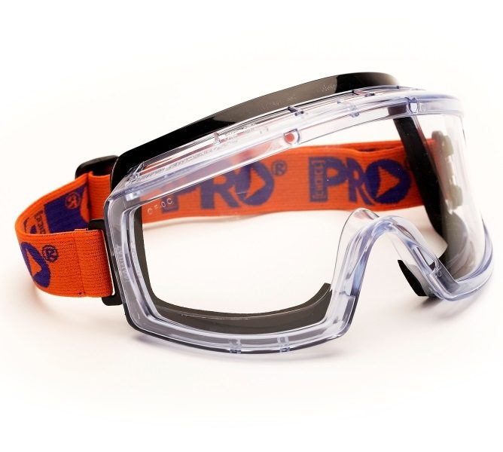
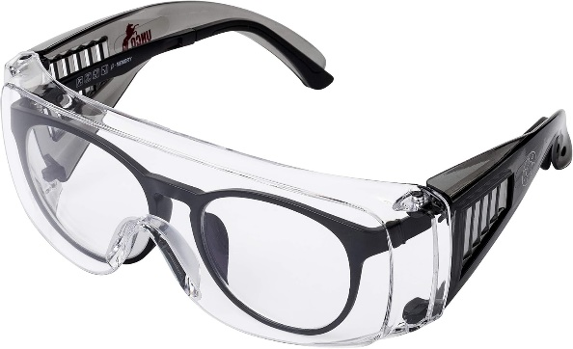
Eye Protection
Eye protection comes in a variety of options depending on the work scope, environment and specific requirements of the role. This can include safety glasses, mono goggles, over glasses, full face shield, air fed face masks and other formats.
Protection of the eyes from impacts, foreign bodies and other external factors is a critical component of PPE requirements and operations on the majority or work sites and areas.
Where safety glasses are required, they should be worn correctly as intended, across the bridge of your nose, and covering completely the eyes. Correct fitting for goggles and face masks may require support from PPE provider/manufacturer or client site representative.
Care for your eyes is of critical importance, adherence to direction to wear eye protection is a requirement on all Engage Us client sites.

Slide 8
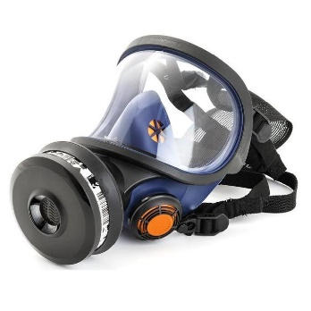
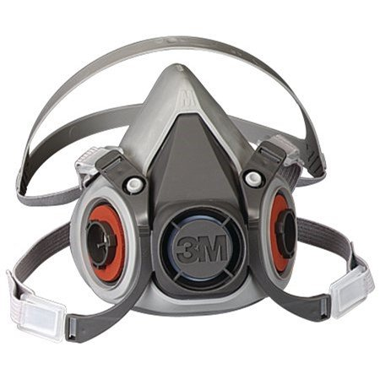
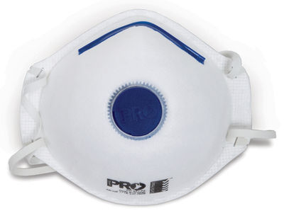
Respiratory Protection
Respiratory Protective Equipment (RPE) is a type of Personal Protective Equipment (PPE). RPE is a last defence in protecting the wearer from different forms of airborne contaminants.
When managing health and safety risks arising from respiratory hazards, knowing the correct form(s) a hazardous substance takes is important in ensuring the most appropriate and effective control measure is implemented. RPE can take the form of face masks, full particulate masks,. breathing apparatus, air fed units, full enclosure units.
Engage Client sites assess and monitor the exposure levels and potential exposure type to ensure the correct application of RPE for each instance, it is incumbent on the employee to follow all directions, instructions and practices for usage of RPE in the correct environment.
When using masks – it is essential that masks are secured snugly over the nose and mouth, adjusting any straps to ensure a tight seal.
Solid Particles Liquid Particles Vapour Gas | Asbestos, Lead, Exhaust, Welding Fumes, etc. Paints, Pesticides, Cutting fluids, chrome, etc. Solvent, Glue, Petrol, etc. Carbon Monoxide, Sewer, Chlorine etc.

Slide 9
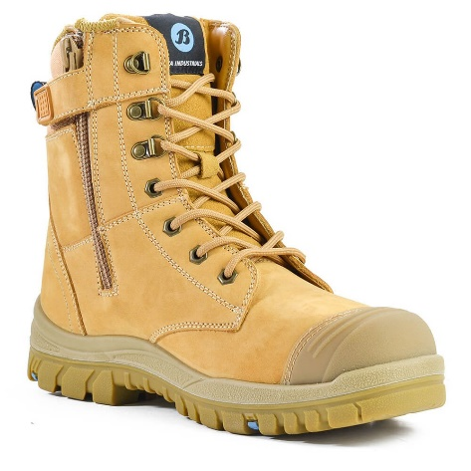
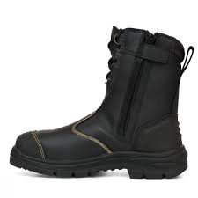
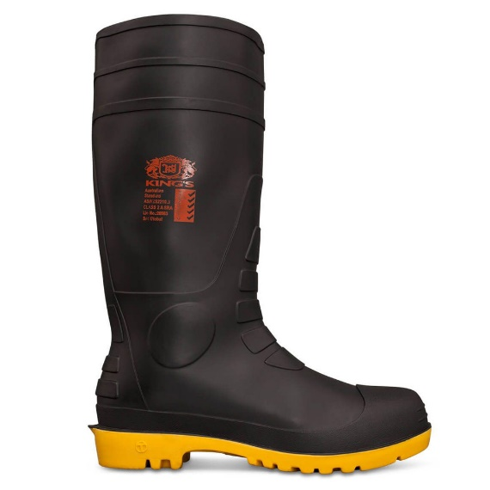
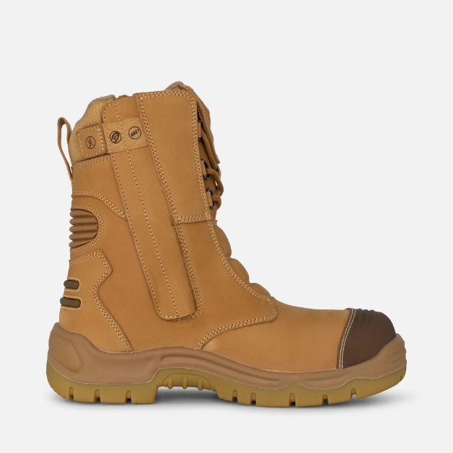
Protective Footwear / Safety Boots
The correct fitting of protective footwear is very important as workers are more likely to adopt a responsible attitude towards the protection of their feet.
Safety Steel Caps, hardened or protected toes and durable hard wearing material footwear is essential in almost every worksite.
Specifications for style, material, coverage and fastening will be defined prior to commencement on site.
Zipped and Laced boots are now more common than slip on – secure the laces tightly and ensure the ankles are covered.
Inspection of footwear should take into account, grip, surface tears, lace condition and other external components to ensure protection.

Slide 10
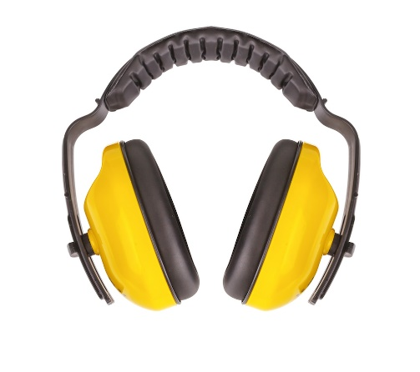
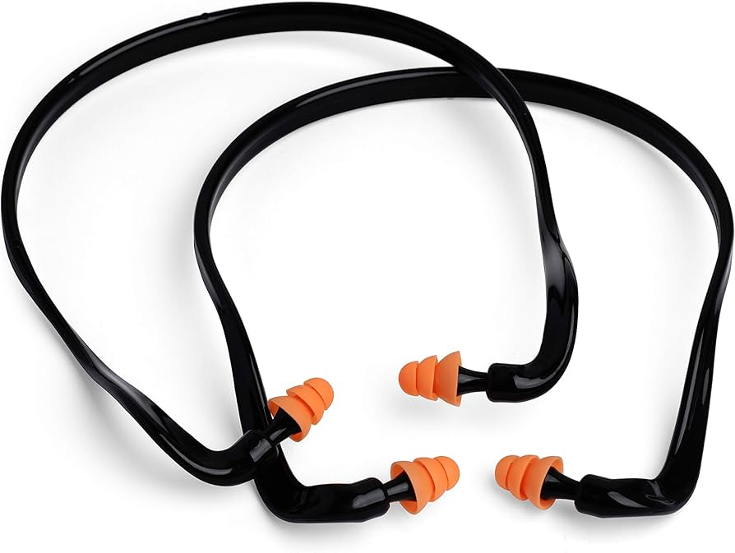
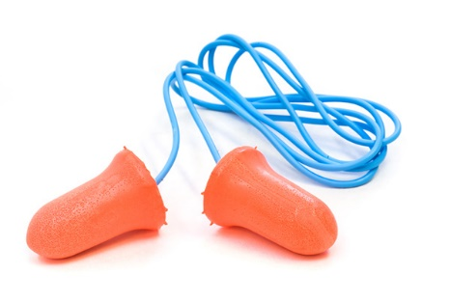
Hearing Protection
Hearing protection refers to devices like earplugs and earmuffs designed to reduce exposure to harmful noise levels and prevent hearing damage.
Devices such as earplugs and earmuffs, are essential for safeguarding your ears from harmful noise levels. Correct usage will ensure highest protection available:
Choose the Right Type: Select earplugs or earmuffs that are suitable for your environment and provide the necessary noise reduction. Fit Properly: Ensure earplugs are inserted fully into the ear canal, forming a tight seal. Earmuffs should cover the entire ear without gaps. Wear Consistently: Always wear hearing protection in noisy environments, even for short durations, to prevent cumulative damage. Check Condition: Regularly inspect your hearing protection for wear and tear, and replace them if they are damaged or no longer fit well. Combine When Necessary: In extremely loud environments, use both earplugs and earmuffs together for additional protection.
Proper use of hearing protection helps prevent noise-induced hearing loss and ensures long-term ear health.

Slide 11
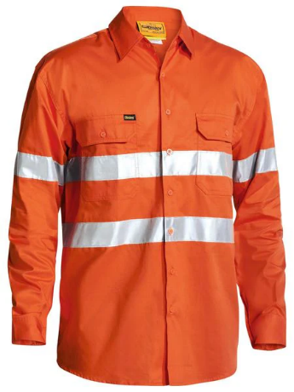
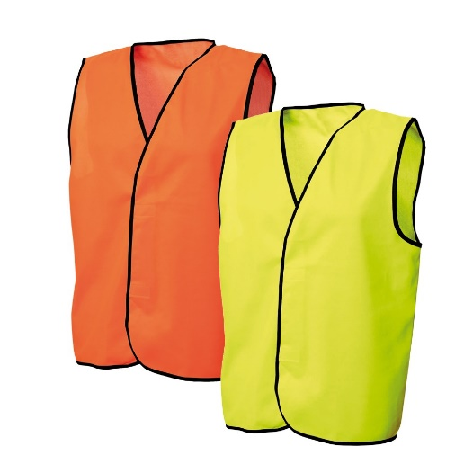
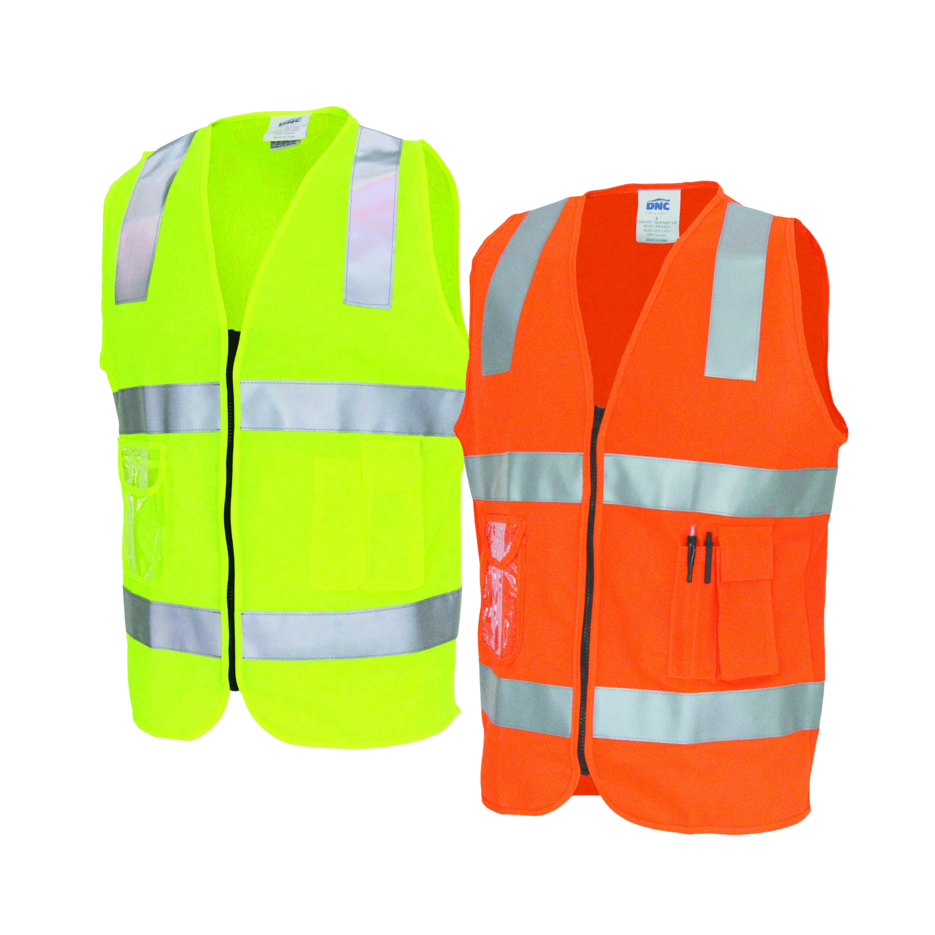
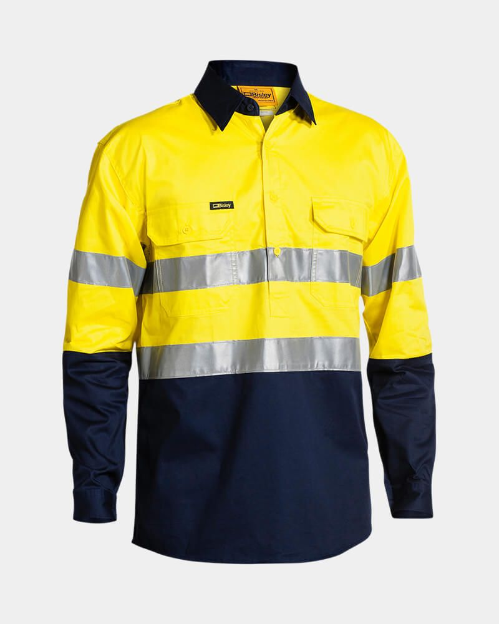
High Visibility Clothing
High Visibility clothing is a staple in any working environment. Bright colours combined with reflective tape provides visual indicators for all employees in a working environment.
Sites will determine specific requirements such as long sleeves, material make up, tape pattern and other identifying factors.
It is essential that this PPE is well maintained and fit for purpose. It is your responsibility to manage, care and maintain your shirts, pants, overalls or other items to ensure.
Where reflective tape is required, ensure this is not obstructed by other items, ensure the clothing fits and is not loose or untucked.
Confirm site specific requirements with Engage representatives on commencement.

Slide 12
Complete the Induction Questionnaire

